Slide 1
Multi-Agent Design
Patterns
BUILDING SCALABLE AGENTIC SYSTEMS
Korey Stegared-Pace
Senior AI Cloud Advocate, Microsoft

Slide 2
Customer Support in the Real World
Typesof customer tickets
Billing disputes requiring financial knowledge
Technical issues needing engineering support
Legal compliance questions demanding regulatory knowledge
Product recommendations calling for sales acumen
INTRODUCTION TO AI AGENTS

Slide 3
The Problem with Single Agents
Increasingly complex logic
Models using prompts with a high amount of if-else scenarios and edge-cases
Tool overload
Agentic systems where a single model needs to call a wide variety of tools
1
OpenAI, A Practical Guide to Building Agents, https://cdn.openai.com/business-guides-and-resources/a-
practical-guide-to-building-agents.pdf
INTRODUCTION TO AI AGENTS

Slide 4

Multi-Agent Systems
Single Agent Systems
A single model equipped with appropriate tools and instructions executes workflows in a loop
Multi-Agent Systems
Execute workflows across multiple coordinated agents
1
OpenAI, A Practical Guide to Building Agents, https://cdn.openai.com/business-guides-and-resources/a-
practical-guide-to-building-agents.pdf
INTRODUCTION TO AI AGENTS

Slide 5
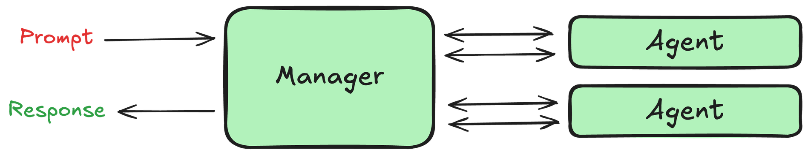
The Manager Pattern
1
OpenAI, A Practical Guide to Building Agents, https://cdn.openai.com/business-guides-and-resources/a-
practical-guide-to-building-agents.pdf
INTRODUCTION TO AI AGENTS

Slide 6
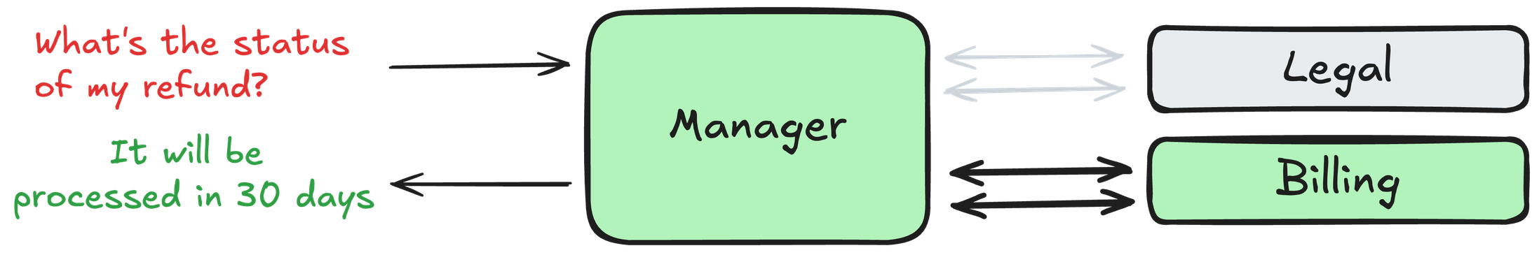
The Manager Pattern Applied
1
OpenAI, A Practical Guide to Building Agents, https://cdn.openai.com/business-guides-and-resources/a-
practical-guide-to-building-agents.pdf
INTRODUCTION TO AI AGENTS

Slide 7
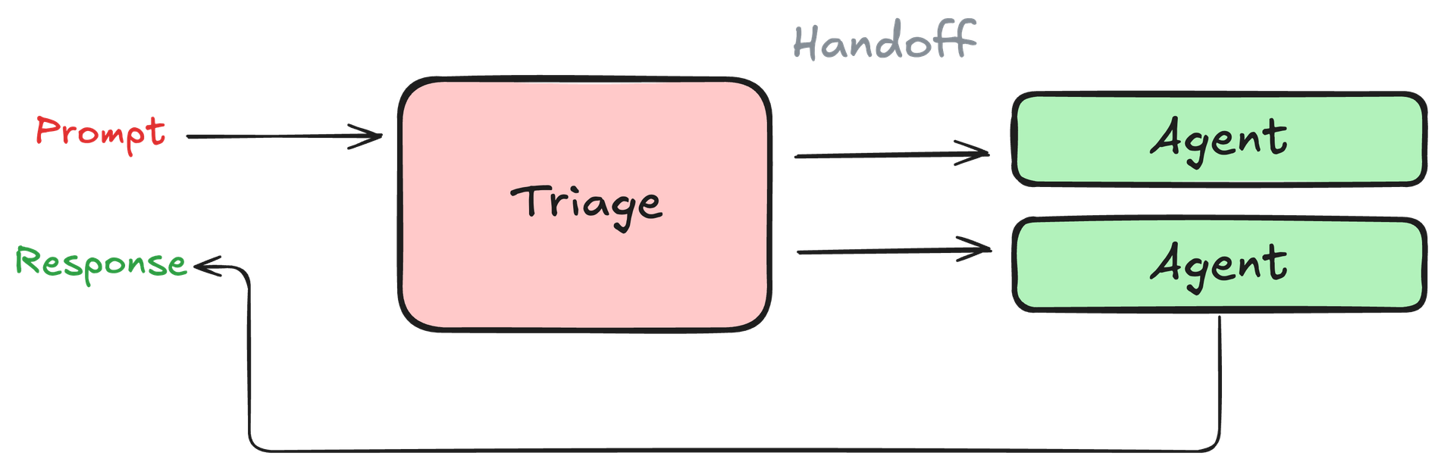
The Decentralized Pattern
1
OpenAI, A Practical Guide to Building Agents, https://cdn.openai.com/business-guides-and-resources/a-
practical-guide-to-building-agents.pdf
INTRODUCTION TO AI AGENTS

Slide 8
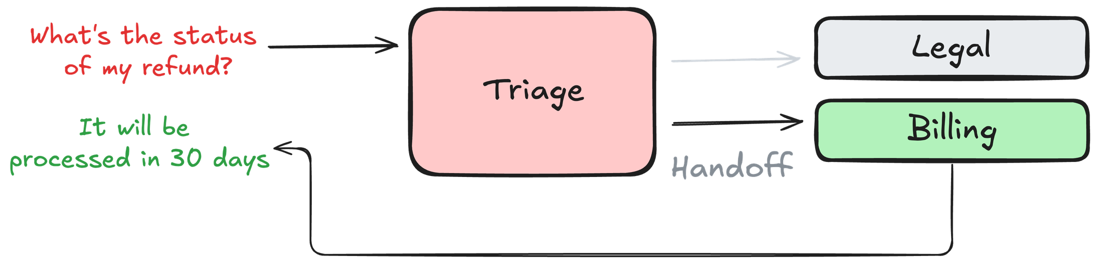
The Decentralized Pattern Applied
1
OpenAI, A Practical Guide to Building Agents, https://cdn.openai.com/business-guides-and-resources/a-
practical-guide-to-building-agents.pdf
INTRODUCTION TO AI AGENTS

Slide 9
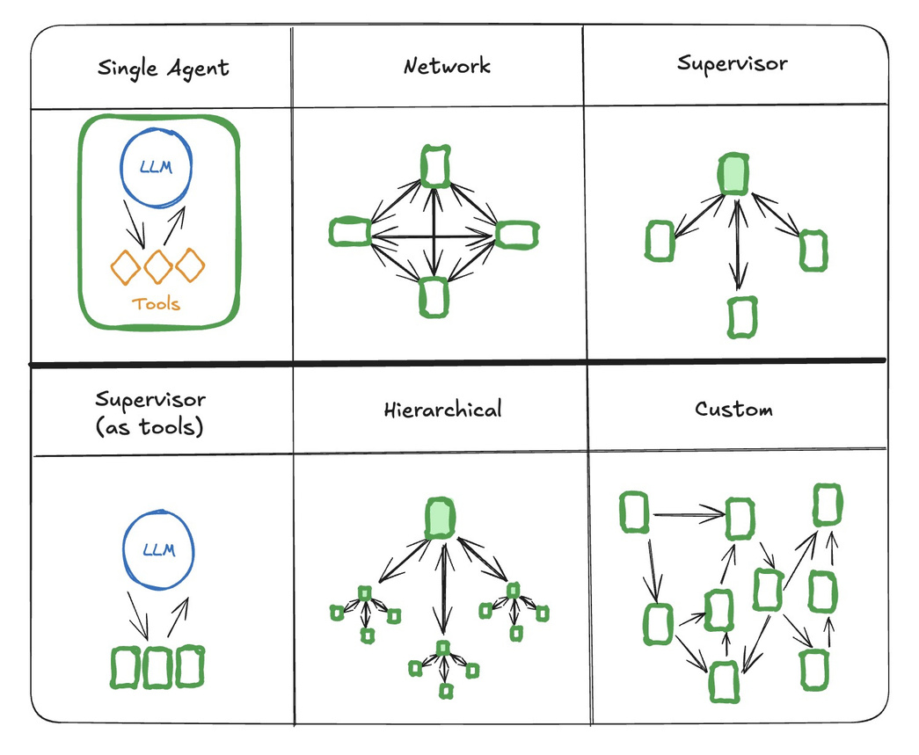
Emerging Agent Architectures
1
LangGraph Multi Agent Systems, https://langchain-ai.github.io/langgraph/concepts/multi_agent/
INTRODUCTION TO AI AGENTS

Slide 10
From One to Many: Multi-Agent Systems
1
Image generated with GPT-4o
INTRODUCTION TO AI AGENTS

Slide 11
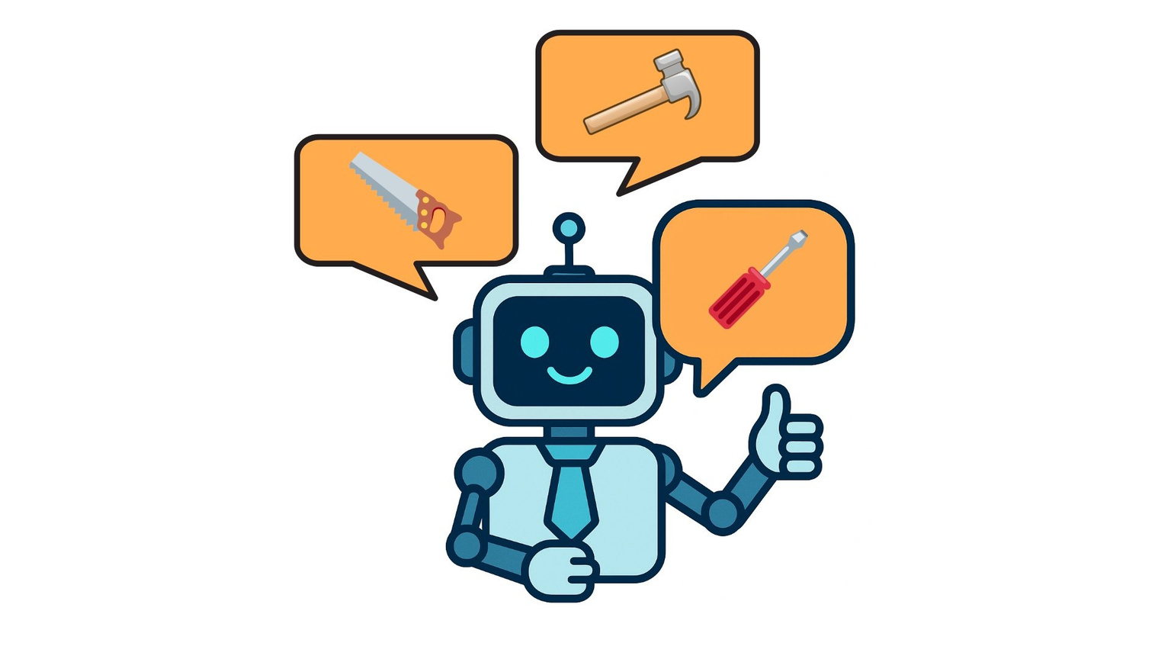
Single Agent
BUILDING SCALABLE AGENTIC SYSTEMS

Slide 12
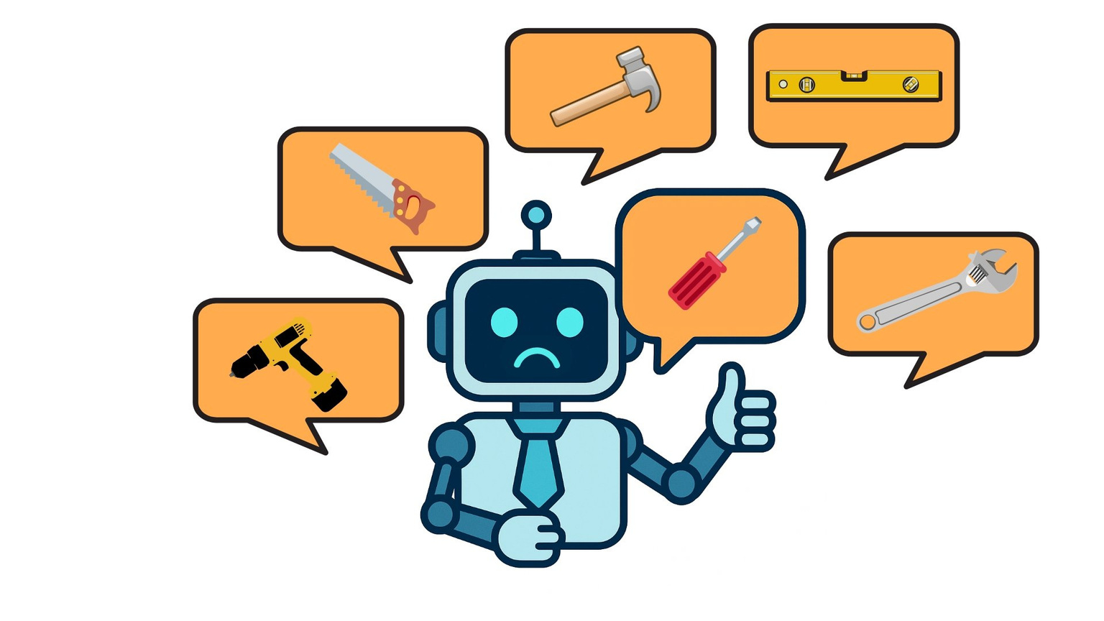
Single Agent
BUILDING SCALABLE AGENTIC SYSTEMS

Slide 13
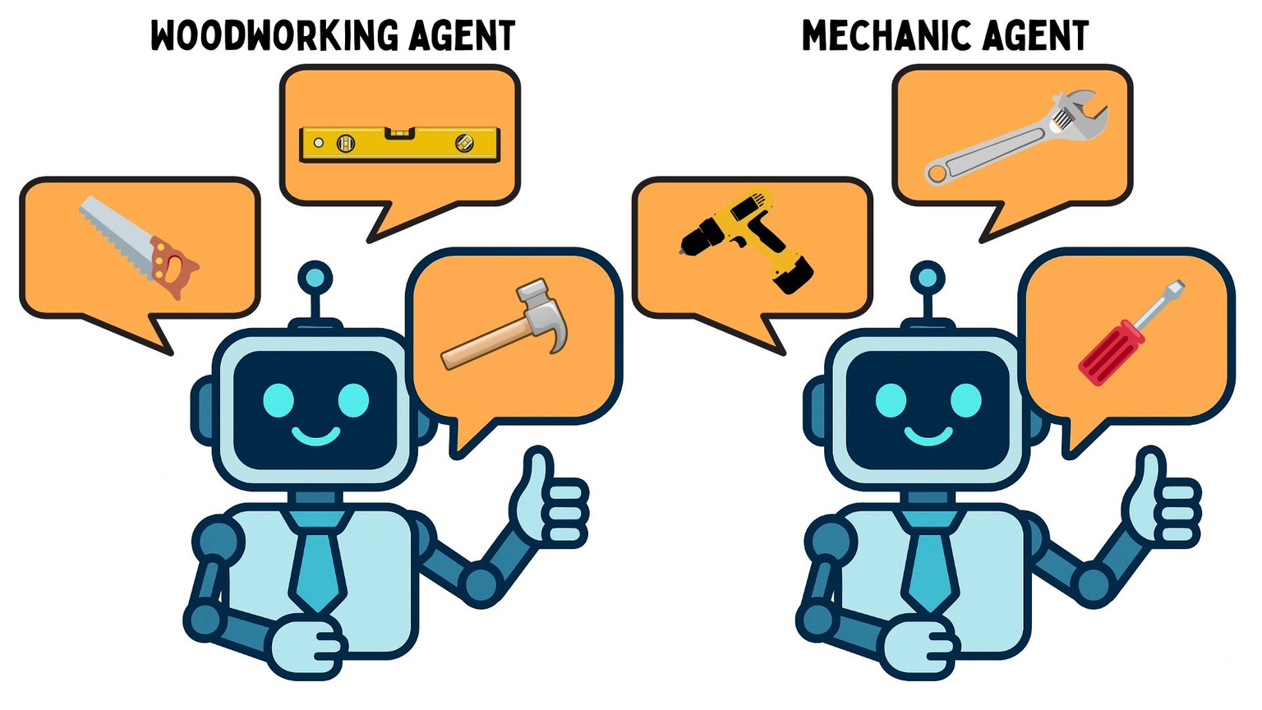
Multi-Agent
BUILDING SCALABLE AGENTIC SYSTEMS

Slide 14
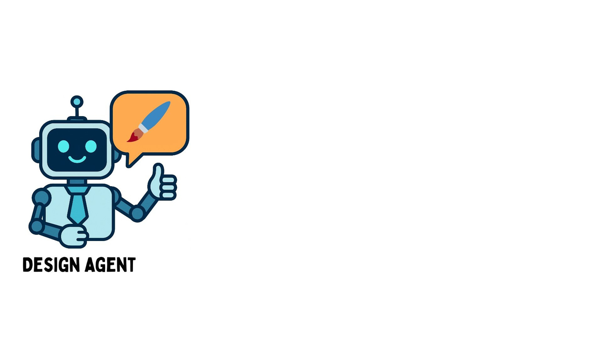
Example: A web app multi-agent
BUILDING SCALABLE AGENTIC SYSTEMS

Slide 15
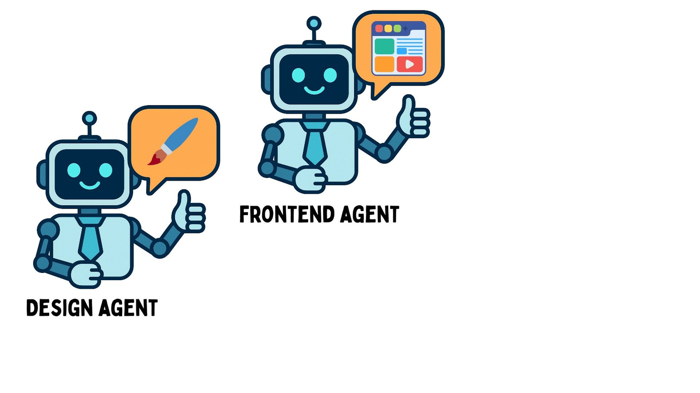
Example: A web app multi-agent
BUILDING SCALABLE AGENTIC SYSTEMS

Slide 16
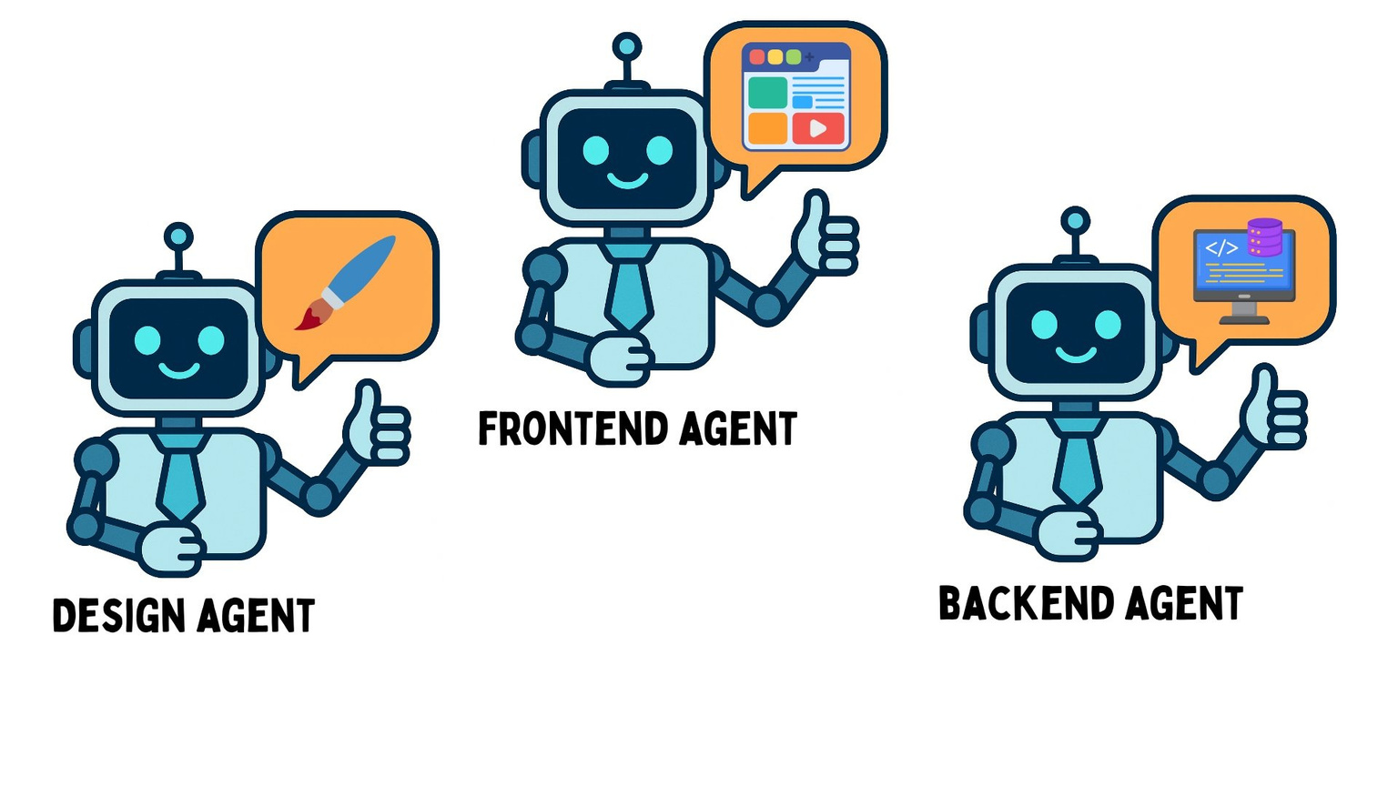
Example: A web app multi-agent
BUILDING SCALABLE AGENTIC SYSTEMS

Slide 17
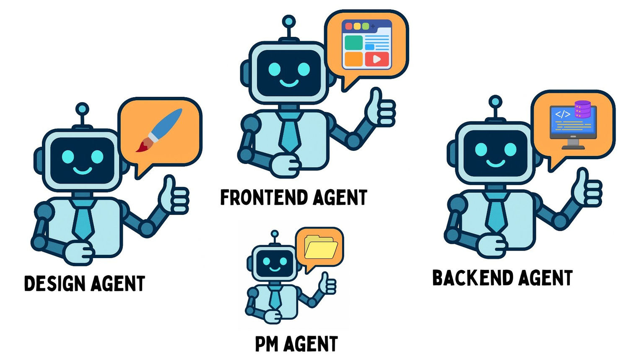
Example: A web app multi-agent
BUILDING SCALABLE AGENTIC SYSTEMS

Slide 18
Multi-agent design patterns
1
BUILDING SCALABLE AGENTIC SYSTEMS

Slide 19
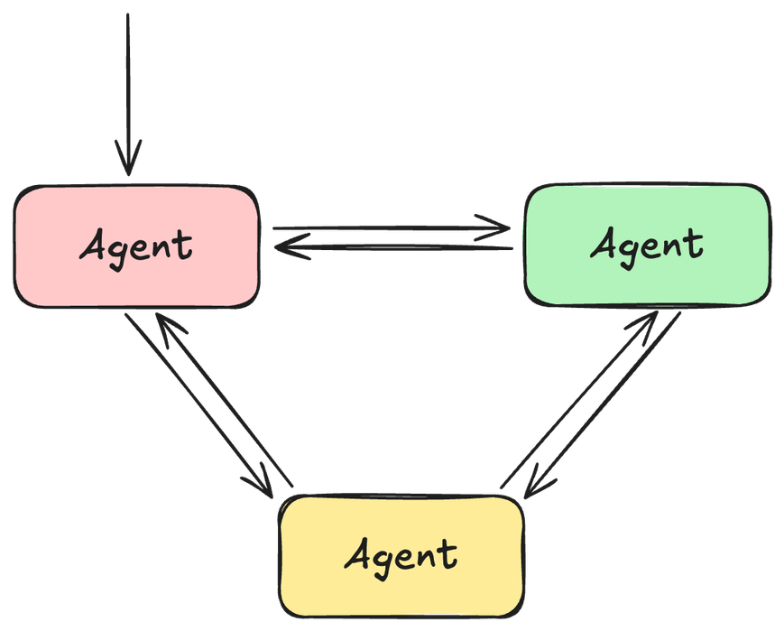
Network multi-agents
Also called
swarm or decentralized
1
BUILDING SCALABLE AGENTIC SYSTEMS

Slide 20
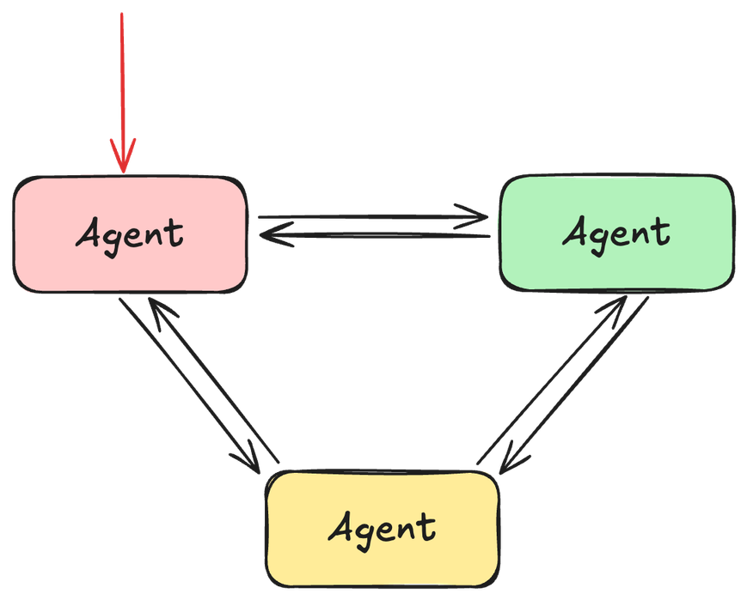
Network multi-agents
Also called
swarm or decentralized
1.
Input is sent to an initial agent
BUILDING SCALABLE AGENTIC SYSTEMS

Slide 21
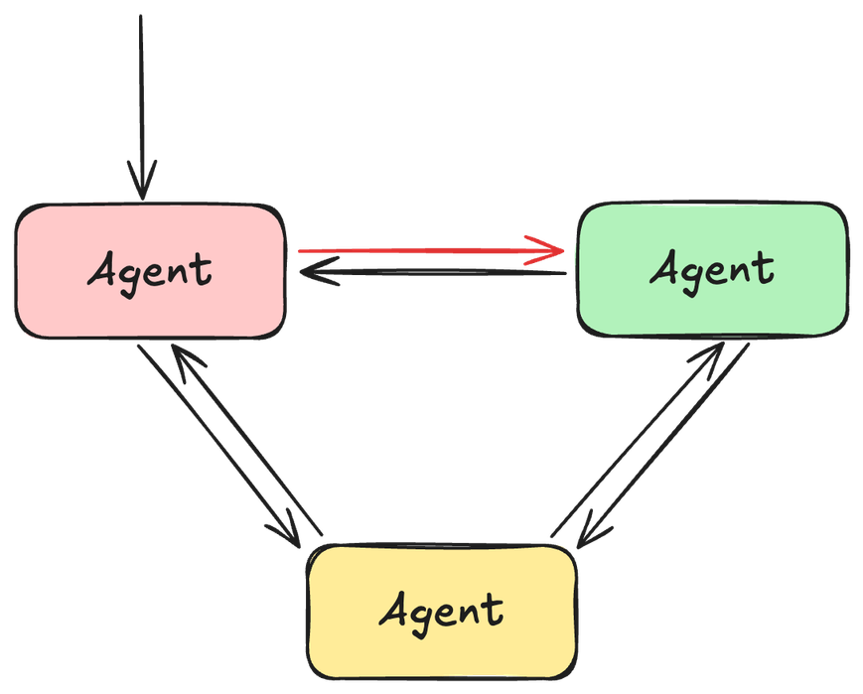
Network multi-agents
Also called
swarm or decentralized
1. Input is sent to an initial agent
2. Agents handoff to one another to complete
the task
BUILDING SCALABLE AGENTIC SYSTEMS

Slide 22
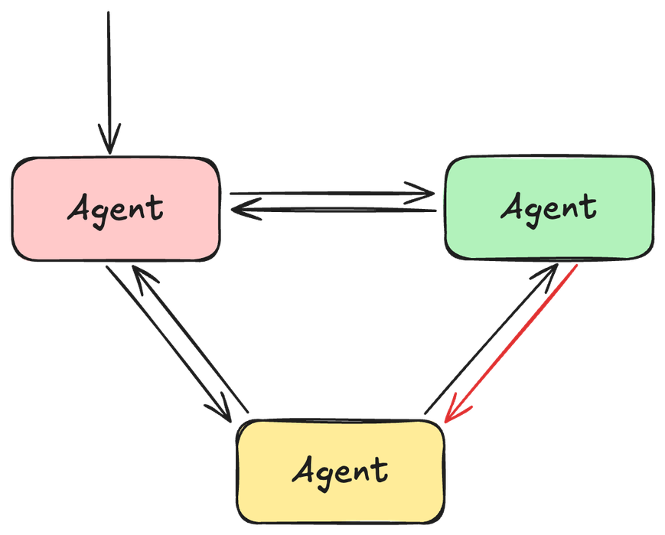
Network multi-agents
Also called
swarm or decentralized
1. Input is sent to an initial agent
2. Agents handoff to one another to complete
the task
BUILDING SCALABLE AGENTIC SYSTEMS

Slide 23
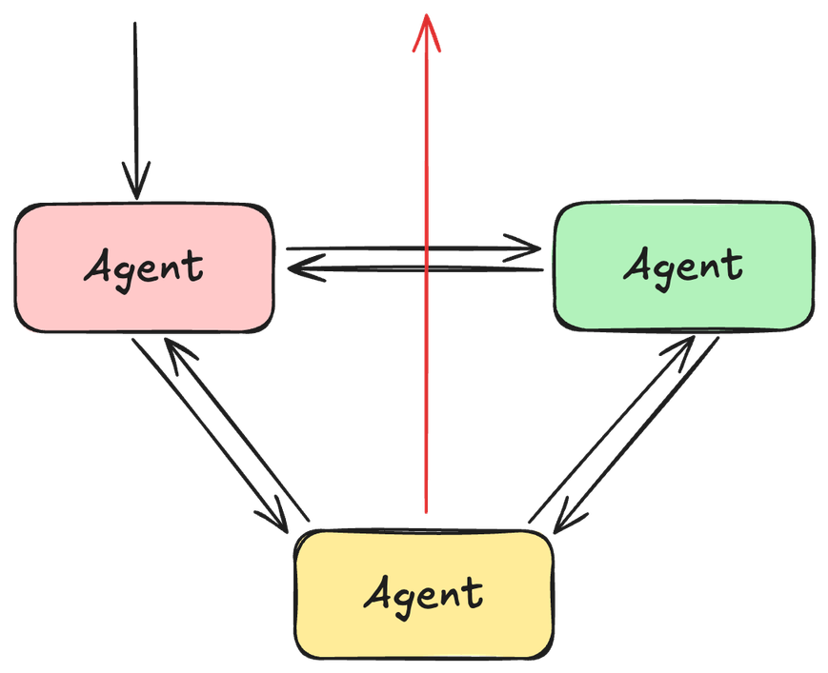
Network multi-agents
Also called
swarm or decentralized
1. Input is sent to an initial agent
2. Agents handoff to one another to complete
the task
BUILDING SCALABLE AGENTIC SYSTEMS

Slide 24
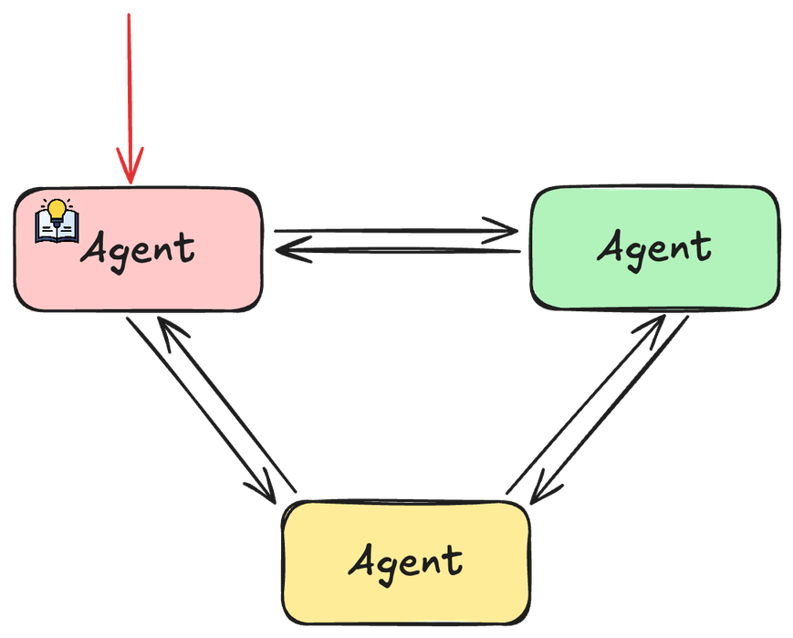
Network multi-agents
Also called
swarm or decentralized
1. Input is sent to an initial agent
2. Agents handoff to one another to complete
the task
BUILDING SCALABLE AGENTIC SYSTEMS

Slide 25
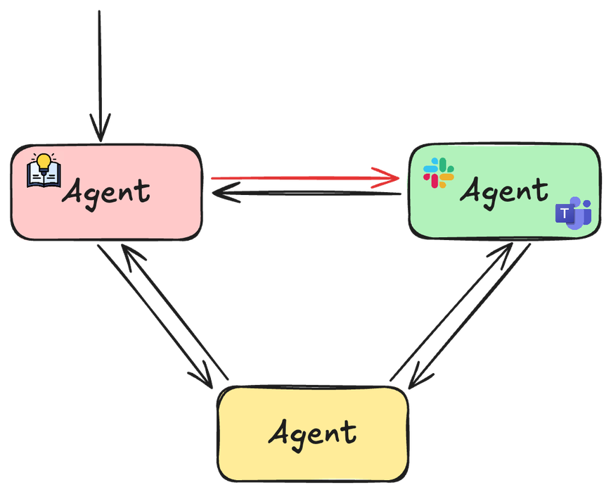
Network multi-agents
Also called
swarm or decentralized
1. Input is sent to an initial agent
2. Agents handoff to one another to complete
the task
BUILDING SCALABLE AGENTIC SYSTEMS

Slide 26
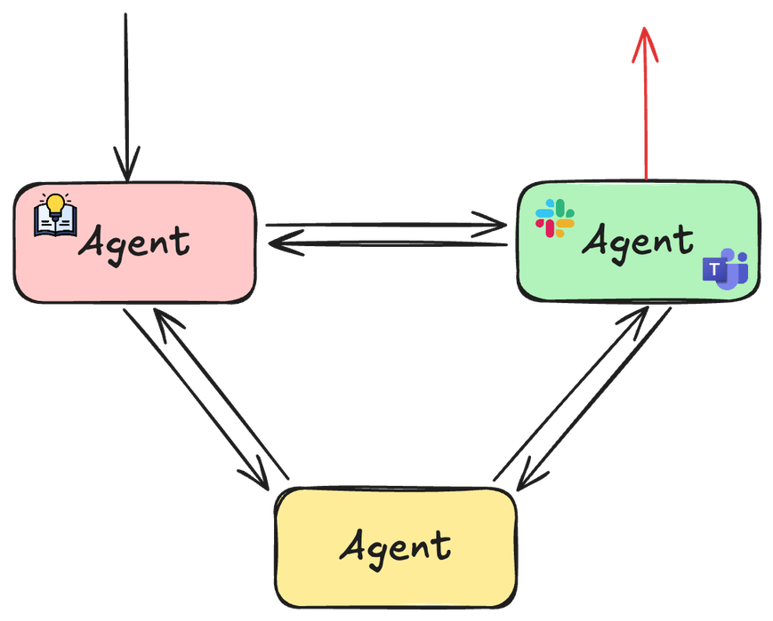
Network Multi-agents
Also called
swarm or decentralized
1. Input is sent to an initial agent
2. Agents handoff to one another to complete
the task
3. Each agent can end the workflow and
respond to the user
BUILDING SCALABLE AGENTIC SYSTEMS

Slide 27
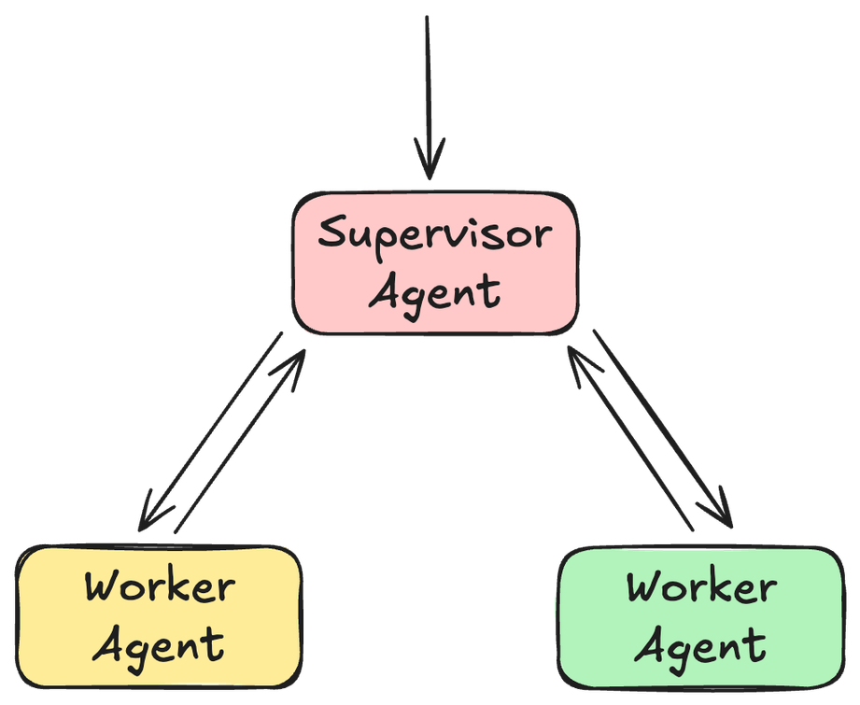
Supervisor multi-agents
1. Input sent to a
supervisor agent
2. Supervisor hands tasks off to
worker
agents
3. Workers execute their tools and report
back to the supervisor
4. Supervisor responds to the user
BUILDING SCALABLE AGENTIC SYSTEMS

Slide 28
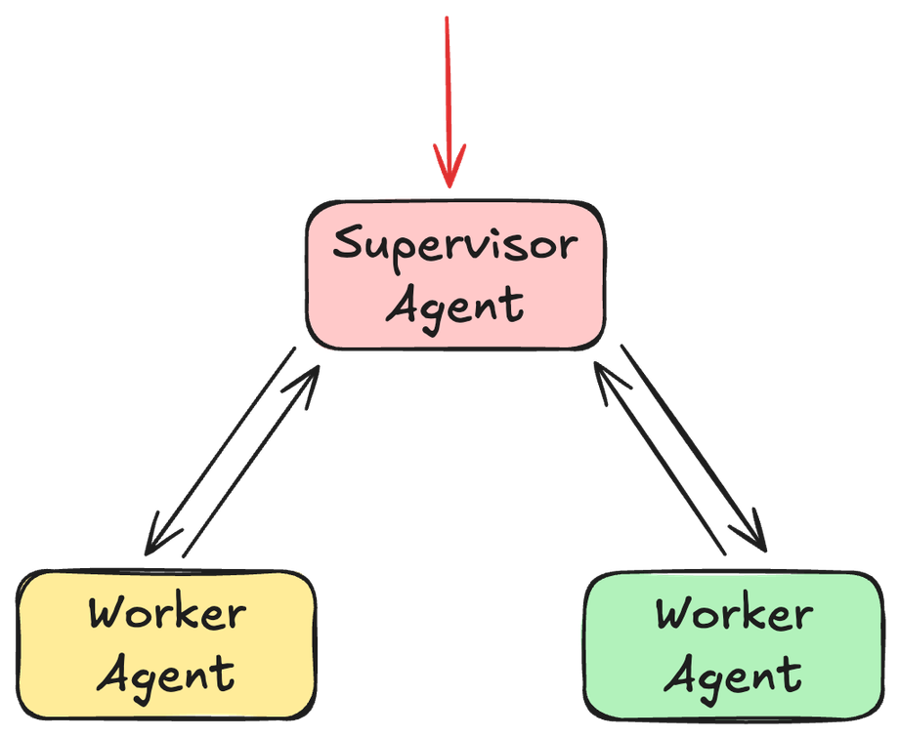
Supervisor Multi-agents
1. Input sent to a
supervisor agent
2. Supervisor hands tasks off to
worker
agents
3. Workers execute their tools and report
back to the supervisor
4. Supervisor responds to the user
BUILDING SCALABLE AGENTIC SYSTEMS

Slide 29
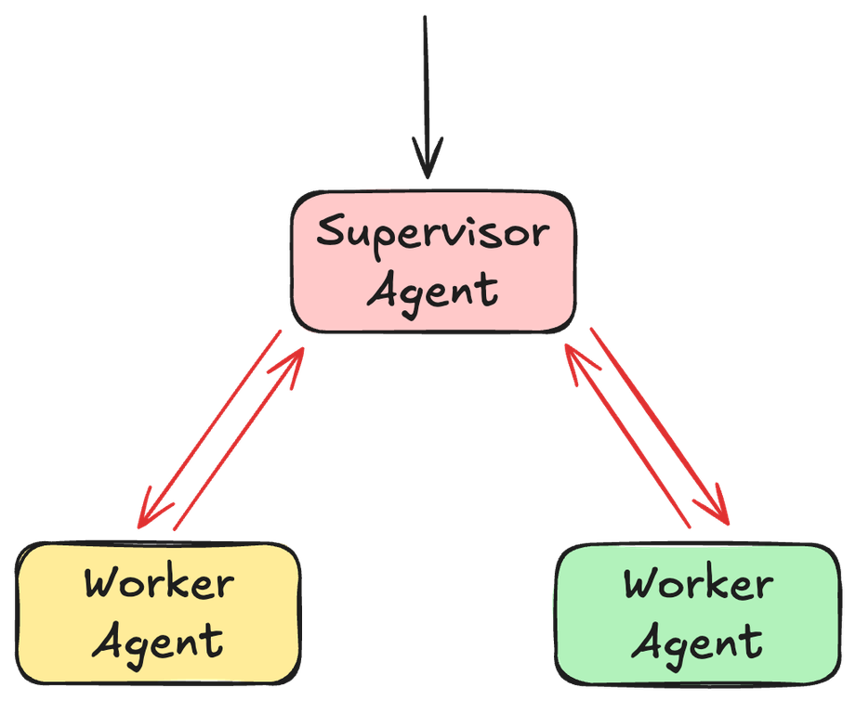
Supervisor Multi-agents
1. Input sent to a
supervisor agent
2. Supervisor hands tasks off to
worker
agents
3. Workers execute their tools and report
back to the supervisor
4. Supervisor responds to the user
BUILDING SCALABLE AGENTIC SYSTEMS

Slide 30
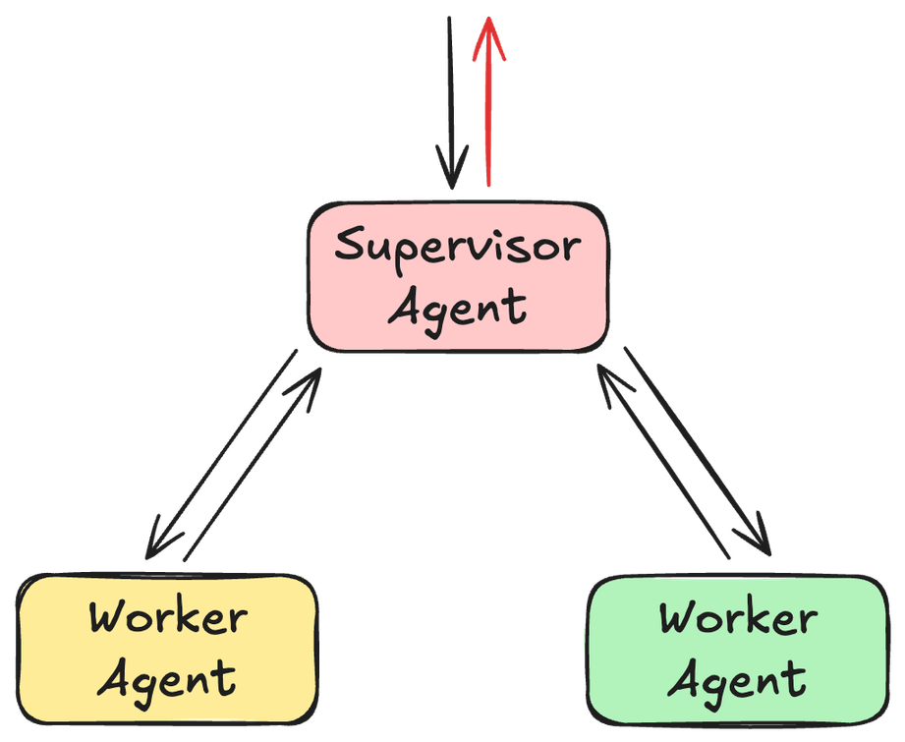
Supervisor Multi-agents
1. Input sent to a
supervisor agent
2. Supervisor hands tasks off to
worker
agents
3. Workers execute their tools and report
back to the supervisor
4. Supervisor responds to the user
BUILDING SCALABLE AGENTIC SYSTEMS

Slide 31
Thank You
BUILDING SCALABLE AGENTIC SYSTEMS

